Slide 1
SQL QUERIES

Slide 2
DDL - DDL is abbreviation of Data Definition Language. It is used to create and modify the structure of database objects in database.
Examples: CREATE, ALTER, DROP statements
DML - DML is abbreviation of Data Manipulation Language. It is used to retrieve, store, modify, delete, insert and update data in database.
Examples: UPDATE, INSERT, DELETE statements etc.
DCL - DCL is abbreviation of Data Control Language. It is used to create roles, permissions, and referential integrity as well it is used to control access to database by securing it.
Examples: GRANT, REVOKE statements
TCL - TCL is abbreviation of Transactional Control Language. It is used to manage different transactions occurring within a database.
Examples: COMMIT, ROLLBACK statements..
DQL: Data Query Language . DQL is used to fetch the data from the database.
Example: select

Slide 3
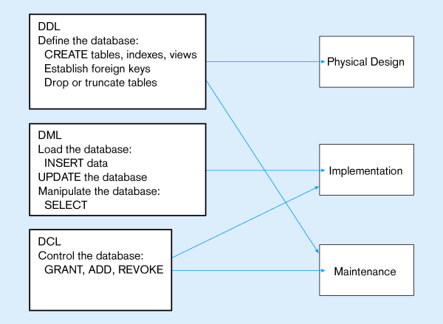

Slide 4
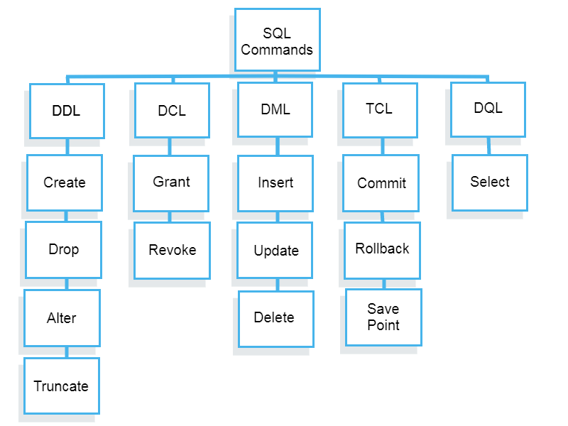

Slide 5
DDL : Creating a Database
To initialize a new database:
Syntax:
CREATE DATABASE database_name

Slide 6
Tables in the Oracle Database
User Tables:
Are a collection of tables created and maintained by the user
Contain user information
Data Dictionary:
Is a collection of tables created and maintained by the Oracle Server
Contain database information

Slide 7
DDL : 1) Creating a Table
Syntax
CREATE TABLE table_name
(Column_name1 datatype1[(size)],
Column_name2 datatype2[(size)],
Column_name n datatypen[(size)],
);

Slide 8
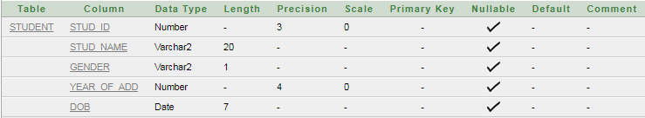
Example:
CREATE TABLE student (Stud_id number(3), Stud_name varchar2(20), Gender varchar2(1), Year_of_Add number(4), DOB date);
describe student;

Slide 9
DDL : 2) ALTER Table
Use the ALTER TABLE statement to:
Add a new column
Modify an existing column
Change data type ,size of column
Define a default value for the new column
Drop a column

Slide 10
A)Adding column
Syntax:
ALTER TABLE table_name
ADD (column datatype [Default Expression])
[REFERENCES table_name (column name)’
[CHECK condition]
EX: ALTER TABLE student add (address varchar2(30));
You cannot specify where the column is to appear.
The new column becomes the last column.

Slide 11
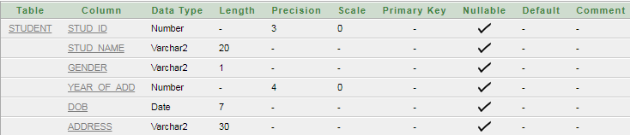
EX: ALTER TABLE student add (address varchar2(30));

Slide 12
B) Modifying a Column
You can change a column’s data type, size, and default value.
ALTER TABLE student modify(stud_id number(2));
A change to the default value affects only subsequent insertions to the table.

Slide 13
3)RENAME: Changing the Name of an Object
To change the name of a table, view, sequence, or synonym, you execute the RENAME statement.
You must be the owner of the object.
Syntax :
RENAME old_name TO new_name;
RENAME student TO Student1;

Slide 14
4) Truncating a Table
The TRUNCATE TABLE statement:
Removes all rows from a table
Releases the storage space used by that table
Syntax: TRUNCATE table <tablename>;
You cannot roll back row removal when using TRUNCATE.
Alternatively, you can remove rows by using the DELETE statement.
TRUNCATE statement is faster than removing them with the DELETE statement.

Slide 15
5)Dropping a Column
Use the DROP COLUMN clause to drop columns you no longer need from the table.
The column may or may not contain data.
Using the ALTER TABLE statement, only one column can be dropped at a time.
The table must have at least one column remaining in it after it is altered.
Once a column is dropped, it cannot be recovered.
EXAMPLE : ALTER TABLE student Drop column Year_of_Add;

Slide 16
5A)Drop Statement
Drop statement is used to drop table.
All data and structure in the table is deleted.
Any pending transactions are committed.
All indexes are dropped.
You cannot roll back the DROP TABLE statement.
DROP TABLE <tablename>;
DROP TABLE student;

Slide 17
DML:
Data Manipulation Language:
It is used to retrieve, store, modify, delete, insert and update data in database.
1)Insert into
2)Update
3)Delete

Slide 18
1)Insert into
The INSERT INTO statement is used to insert new rows into a table.
Syntax
INSERT INTO table_name VALUES (value1, value2,....) ;
You can also specify the columns for which you want to insert data:
INSERT INTO table_name (column1, column2,...) VALUES (value1, value2,....) ;

Slide 19
Insert a New Row
Last_Name
First_Name
Address
City
Pettersen
Kari
Storgt 20
Stavanger
And this SQL statement:
INSERT INTO Persons VALUES ('Hetland', 'Camilla', 'Hagabakka 24', 'Sandnes');
Last_Name
First_Name
Address
City
Pettersen
Kari
Storgt 20
Stavanger
Hetland
Camilla
Hagabakka 24
Sandnes

Slide 20
Insert Data in Specified Columns
Last_Name
First_Name
Address
City
Pettersen
Kari
Storgt 20
Stavanger
Hetland
Camilla
Hagabakka 24
Sandnes
And This SQL statement:
INSERT INTO Persons (Last_Name, Address)VALUES ('Rusmuseen', 'Storgt 67');
Last_Name
First_Name
Address
City
Pettersen
Kari
Storgt 20
Stavanger
Hetland
Camilla
Hagabakka 24
Sandnes
Rusmuseen
Storgt 67

Slide 21
2) UPDATE Statement
The UPDATE statement is used to modify the data in a table.
Syntax
UPDATE table_name SET column_name1 = value1, column_name2 = value2, ….. [WHERE Condition]
Or
UPDATE table_name SET column_name = new_value
WHERE column_name = some_value /Old_value;

Slide 22
2a)Update one Column in a Row
Last_Name
First_Name
Address
City
Nilsen
Fred
Kirkegt 56
Stavanger
Rusmuseen
Storgt 67
We want to add a first name to the person with a last name of "Rasmussen":
UPDATE Person SET First_Name = ‘Nina’ WHERE Last_Name = 'Rusmuseen' ;
Last_Name
First_Name
Address
City
Nilsen
Fred
Kirkegt 56
Stavanger
Rusmuseen
Nina
Storgt 67

Slide 23
2b) Update several Columns in a Row
Last_Name
First_Name
Address
City
Nilsen
Fred
Kirkegt 56
Stavanger
Rusmuseen
Storgt 67
We want to change the address and add the name of the city:
UPDATE Person SET Address = 'Stien12', City = 'Stavanger‘
WHERE Last_Name = 'Rusmuseen' ;
Last_Name
First_Name
Address
City
Nilsen
Fred
Kirkegt 56
Stavanger
Rusmuseen
Nina
Stien 12
Stavanger

Slide 24
3) The Delete Statement
The DELETE statement is used to delete rows in a table.
Syntax
DELETE FROM table_name WHERE column_name = some_value ;

Slide 25
3a) Delete a Row
Last_Name
First_Name
Address
City
Nilsen
Fred
Kirkegt 56
Stavanger
Rasmussen
Nina
Stien 12
Stavanger
"Nina Rasmussen" is going to be deleted:
DELETE FROM Person WHERE Last_Name = 'Rasmussen‘ ;
Last_Name
First_Name
Address
City
Nilsen
Fred
Kirkegt 56
Stavanger

Slide 26
3b) Delete All Rows
It is possible to delete all rows in a table without deleting the table. This means that the table structure, attributes, and indexes will be intact:
DELETE FROM table_name ;

Slide 27
Miscellaneous Commands :
SELECT * FROM ALL_TABLES;
Show all tables from the databases .
show tables;
Show all the tables of the present database
drop table t_name;
Delete the entire table t_name
drop database db_name;
Delete the entire database db_name

Slide 28
Constraints
How to Describe constraints
How to Create and maintain constraints

Slide 29
Constraints
Constraints enforce rules at the table level whenever a row is inserted, updated, or deleted from that table.
Constraints prevent the deletion of a table if there are dependencies(means relationship between two or more attributes.)
The following constraint types are valid:
NOT NULL
UNIQUE
PRIMARY KEY
FOREIGN KEY
CHECK

Slide 30
Constraints
Name a constraint or the Oracle server generates a name by using the SYS_Cn format.
Create a constraint either:
At the same time as the table is created, or
After the table has been created.
Define a constraint at the column or table level.
View a constraint in the data dictionary.

Slide 31
Defining Constraints
Column constraint level
Table constraint level
column [CONSTRAINT constraint_name] constraint_type,
column,...
[CONSTRAINT constraint_name] constraint_type
(column, ...),
Notes:
Defining Constraints (continued)
Constraints are usually created at the same time as the table. Constraints can be added to a table after its creation and also temporarily disabled.
Constraints can be defined at one of two levels.
In the syntax:
constraint_name is the name of the constraint
constraint_type is the type of the constraint
Instructor Note
Explain that the column level and the table level refer to location in the syntax.

Slide 32
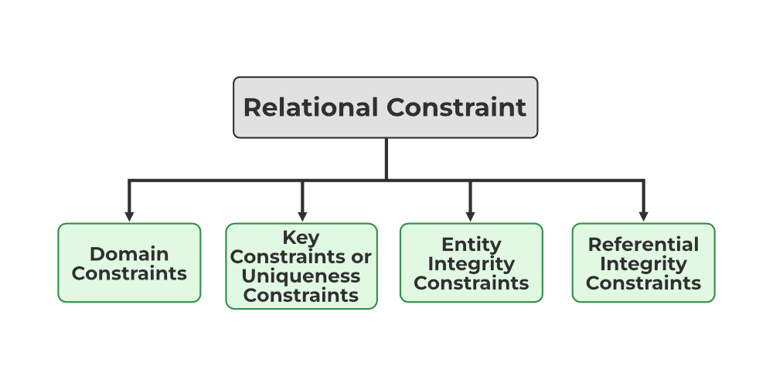
TYPE OF CONSTRAINT

Slide 33
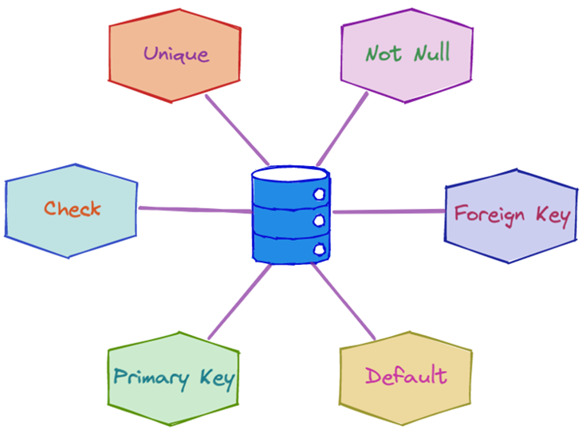
Domain Constraints
Define the valid values that an attribute (column) can hold.
Specify the data type (e.g., integer, string, date) and any additional restrictions (e.g., range of values, allowed patterns).

Slide 34
Not Null Constraint
CREATE TABLE TableName ( Column1 DataType NOT NULL, Column2 DataType, -- Other columns );

Slide 35
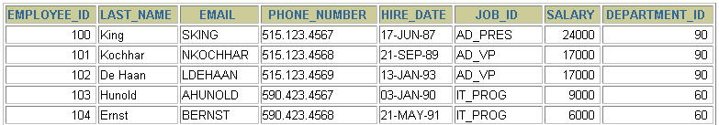
The NOT NULL Constraint
Ensures that null values are not permitted for the column:
…
NOT NULL constraint
(No row can contain a null value for this column.)
NOT NULL
constraint
Absence of NOT NULL constraint
(Any row can contain null for this column.)
Notes:
The NOT NULL Constraint
The NOT NULL constraint ensures that the column contains no null values. Columns without the NOT NULL constraint can contain null values by default.

Slide 36
The NOT NULL Constraint
Is defined at the column level:
CREATE TABLE employees(
employee_id NUMBER(6),
last_name VARCHAR2(25) NOT NULL,
salary NUMBER(8,2),
commission_pct NUMBER(2,2),
hire_date DATE
CONSTRAINT emp_hire_date_nn
NOT NULL,
...
System
named
User
named
Notes:
The NOT NULL Constraint (continued)
The NOT NULL constraint can be specified only at the column level, not at the table level.
The slide example applies the NOT NULL constraint to the LAST_NAME and HIRE_DATE columns of the EMPLOYEES table. Because these constraints are unnamed, the Oracle server creates names for them.
You can specify the name of the constraint when you specify the constraint:
... last_name VARCHAR2(25)
CONSTRAINT emp_last_name_nn NOT NULL...
Note: The constraint examples described in this lesson may not be present in the sample tables provided with the course. If desired, these constraints can be added to the tables.

Slide 37
Unique Constraint:
A unique constraint ensures that all values in a column or a set of columns are unique.
Unlike the primary key, a unique constraint allows NULL values.
Syntax :
CREATE TABLE table_name ( column_name data_type UNIQUE );

Slide 38
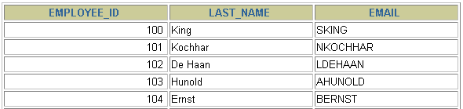
The UNIQUE Constraint
EMPLOYEES
UNIQUE constraint
…
INSERT INTO
Allowed
Not allowed: already exists
Notes:
The UNIQUE Constraint
A UNIQUE key integrity constraint requires that every value in a column or set of columns (key) be unique—that is, no two rows of a table can have duplicate values in a specified column or set of columns. The column (or set of columns) included in the definition of the UNIQUE key constraint is called the unique key. If the UNIQUE constraint comprises more than one column, that group of columns is called a composite unique key.
UNIQUE constraints allow the input of nulls unless you also define NOT NULL constraints for the same columns. In fact, any number of rows can include nulls for columns without NOT NULL constraints because nulls are not considered equal to anything. A null in a column (or in all columns of a composite UNIQUE key) always satisfies a UNIQUE constraint.
Note: Because of the search mechanism for UNIQUE constraints on more than one column, you cannot have identical values in the non-null columns of a partially null composite UNIQUE key constraint.
Instructor Note
Explain to students that since the JSMITH e-mail ID already exists after the first insertion, the second entry is not allowed.

Slide 39
The UNIQUE Constraint
Defined at either the table level or the column level:
CREATE TABLE employees(
employee_id NUMBER(6),
last_name VARCHAR2(25) NOT NULL,
email VARCHAR2(25),
salary NUMBER(8,2),
commission_pct NUMBER(2,2),
hire_date DATE NOT NULL,
...
CONSTRAINT emp_email_uk UNIQUE(email));
Notes:
The UNIQUE Constraint (continued)
UNIQUE constraints can be defined at the column or table level. A composite unique key is created by using the table level definition.
The example on the slide applies the UNIQUE constraint to the EMAIL column of the EMPLOYEES table. The name of the constraint is EMP_EMAIL_UK..
Note: The Oracle server enforces the UNIQUE constraint by implicitly creating a unique index on the unique key column or columns.

Slide 40
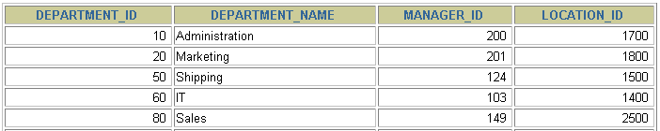
The PRIMARY KEY Constraint
DEPARTMENTS
PRIMARY KEY
…
Not allowed
(Null value)
INSERT INTO
Not allowed
(50 already exists)
Notes:
The PRIMARY KEY Constraint
A PRIMARY KEY constraint creates a primary key for the table. Only one primary key can be created for each table. The PRIMARY KEY constraint is a column or set of columns that uniquely identifies each row in a table. This constraint enforces uniqueness of the column or column combination and ensures that no column that is part of the primary key can contain a null value.

Slide 41
Primary Key
A primary key is a column or a set of columns that uniquely identifies each row in a table.
The primary key constraint ensures that the values in the specified columns are unique and not NULL.
There can be only one primary key in a table.

Slide 42
The PRIMARY KEY Constraint
Defined at either the table level or the column level:
CREATE TABLE departments(
department_id NUMBER(4),
department_name VARCHAR2(30)
CONSTRAINT dept_name_nn NOT NULL,
manager_id NUMBER(6),
location_id NUMBER(4),
CONSTRAINT dept_id_PRIMARY KEY(department_id));
Notes:
The PRIMARY KEY Constraint (continued)
PRIMARY KEY constraints can be defined at the column level or table level. A composite PRIMARY KEY is created by using the table-level definition.
A table can have only one PRIMARY KEY constraint but can have several UNIQUE constraints.
The example on the slide defines a PRIMARY KEY constraint on the DEPARTMENT_ID column of the DEPARTMENTS table. The name of the constraint is DEPT_ID_PK.
Note: A UNIQUE index is automatically created for a PRIMARY KEY column.
Instructor Note
The example shown will not work in your schema because the DEPARTMENTS table already exists. To demonstrate this code, modify the name of the table within the script and then run the script.

Slide 43
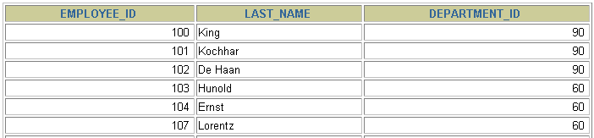
The FOREIGN KEY Constraint
DEPARTMENTS
PRIMARY KEY
…
EMPLOYEES
FOREIGN KEY
…
INSERT INTO
Not allowed (9 does not exist)
Allowed
Notes:
The FOREIGN KEY Constraint
The FOREIGN KEY, or referential integrity constraint, designates a column or combination of columns as a foreign key and establishes a relationship between a primary key or a unique key in the same table or a different table. In the example on the slide, DEPARTMENT_ID has been defined as the foreign key in the EMPLOYEES table (dependent or child table); it references the DEPARTMENT_ID column of the DEPARTMENTS table (the referenced or parent table).
A foreign key value must match an existing value in the parent table or be NULL.
Foreign keys are based on data values and are purely logical, not physical, pointers.
Instructor Note
Explain to students that you cannot create a foreign key without existing primary key values.

Slide 44
Example
Primary key constraint in a relational database using a Students table:
CREATE TABLE Students ( StudentID INT PRIMARY KEY, FirstName VARCHAR(50), LastName VARCHAR(50), Age INT, -- Other columns);
StudentID is the primary key for the Students table.
FirstName, LastName, Age, and other columns are attributes associated with each student.

Slide 45
Conti..
a. Inserting Data:
-- Inserting two students with unique StudentID values INSERT INTO Students (StudentID, FirstName, LastName, Age) VALUES (1, 'John', 'Doe', 20); INSERT INTO Students (StudentID, FirstName, LastName, Age) VALUES (2, 'Jane', 'Smith', 22);
This is valid because each StudentID is unique.
-- Trying to insert a student with a duplicate StudentID INSERT INTO Students (StudentID, FirstName, LastName, Age) VALUES (1, 'Bob', 'Johnson', 21);
This would result in a constraint violation error since the primary key must be unique, and ‘1’ is already used.

Slide 46
Foreign Key Constraint:
A foreign key is a column or a set of columns in a table that refers to the primary key of another table.
It establishes a relationship between the two tables, enforcing referential integrity.
The foreign key constraint ensures that values in the foreign key column(s) match values in the referenced primary key column(s).

Slide 47
FOREIGN KEY Constraint Keywords
FOREIGN KEY: Defines the column in the child table at the table constraint level
REFERENCES: Identifies the table and column in the parent table
ON DELETE CASCADE: Deletes the dependent rows in the child table when a row in the parent table is deleted.
ON DELETE SET NULL: Converts dependent foreign key values to null
Notes:
The FOREIGN KEY Constraint (continued)
The foreign key is defined in the child table, and the table containing the referenced column is the parent table. The foreign key is defined using a combination of the following keywords:
FOREIGN KEY is used to define the column in the child table at the table constraint level.
REFERENCES identifies the table and column in the parent table.
ON DELETE CASCADE indicates that when the row in the parent table is deleted, the dependent rows in the child table will also be deleted.
ON DELETE SET NULL converts foreign key values to null when the parent value is removed.
The default behavior is called the restrict rule, which disallows the update or deletion of referenced data.
Without the ON DELETE CASCADE or the ON DELETE SET NULL options, the row in the parent table cannot be deleted if it is referenced in the child table.

Slide 48
The FOREIGN KEY Constraint
Defined at either the table level or the column level:
CREATE TABLE employees(
employee_id NUMBER(6),
last_name VARCHAR2(25) NOT NULL,
email VARCHAR2(25),
salary NUMBER(8,2),
commission_pct NUMBER(2,2),
hire_date DATE NOT NULL,
...
department_id NUMBER(4),
CONSTRAINT emp_dept_fk FOREIGN KEY (department_id)
REFERENCES departments(department_id),
CONSTRAINT emp_email_uk UNIQUE(email));
Notes:
The FOREIGN KEY Constraint (continued)
FOREIGN KEY constraints can be defined at the column or table constraint level. A composite foreign key must be created by using the table-level definition.
The example on the slide defines a FOREIGN KEY constraint on the DEPARTMENT_ID column of the EMPLOYEES table, using table-level syntax. The name of the constraint is EMP_DEPTID_FK.
The foreign key can also be defined at the column level, provided the constraint is based on a single column. The syntax differs in that the keywords FOREIGN KEY do not appear. For example:
CREATE TABLE employees
(...
department_id NUMBER(4) CONSTRAINT emp_deptid_fk
REFERENCES departments(department_id),
...
)

Slide 49
Example:
1.Customer Table
Oreder Table
CREATE TABLE Customers (
CustomerID INT PRIMARY KEY,
FirstName VARCHAR(50),
LastName VARCHAR(50),
Email VARCHAR(100) UNIQUE,
-- Other columns
);
CREATE TABLE Orders (
OrderID INT PRIMARY KEY,
CustomerID INT,
OrderDate DATE,
TotalAmount DECIMAL(10, 2),
-- Other columns
FOREIGN KEY (CustomerID) REFERENCES Customers(CustomerID)
);

Slide 50
how this foreign key constraint works:
a. Inserting Data:
-- Insert a customer INSERT INTO Customers (CustomerID, FirstName, LastName, Email) VALUES (1, 'John', 'Doe', 'john.doe@example.com'); -- Insert an order referencing the customer INSERT INTO Orders (OrderID, CustomerID, OrderDate, TotalAmount) VALUES (101, 1, '2024-01-06', 150.00);
This ensures that when you insert an order into the Orders table, the CustomerID must exist in the Customers table.
b. Updating Data:
-- Update the CustomerID in the Orders table UPDATE Orders SET CustomerID = 2 WHERE OrderID = 101;
If you try to update the CustomerID in the Orders table to a value that does not exist in the Customers table, it will violate the foreign key constraint.

Slide 51
c. Deleting Data
-- Delete a customer
DELETE FROM Customers WHERE CustomerID = 1;
-- If you try to delete a customer who has orders in the Orders table, it will violate the foreign key constraint

Slide 52
The CHECK Constraint
Defines a condition that each row must satisfy
The following expressions are not allowed:
References to CURRVAL, NEXTVAL, LEVEL, and ROWNUM pseudo columns
Calls to SYSDATE, UID, USER, and USERENV functions
Queries that refer to other values in other rows
..., salary NUMBER(2)
CONSTRAINT emp_salary_min
CHECK (salary > 0),...
Notes:
The CHECK Constraint
The CHECK constraint defines a condition that each row must satisfy. The condition can use the same constructs as query conditions, with the following exceptions:
References to the CURRVAL, NEXTVAL, LEVEL, and ROWNUM pseudocolumns
Calls to SYSDATE, UID, USER, and USERENV functions
Queries that refer to other values in other rows
A single column can have multiple CHECK constraints which refer to the column in its definition. There is no limit to the number of CHECK constraints which you can define on a column.
CHECK constraints can be defined at the column level or table level.
CREATE TABLE employees
(...
salary NUMBER(8,2) CONSTRAINT emp_salary_min
CHECK (salary > 0),
...
Instructor Note
Explain what pseudocolumns are. Pseudocolumns are not actual columns in a table but they behave like columns. For example, you can select values from a pseudocolumn. However, you cannot insert into, update, or delete from a pseudocolumn. Pseudocolumns can be used in SQL statements.

Slide 53
Adding a Constraint Syntax
Use the ALTER TABLE statement to:
Add or drop a constraint, but not modify its structure
Enable or disable constraints
Add a NOT NULL constraint by using the MODIFY clause
ALTER TABLE table
ADD [CONSTRAINT constraint] type (column);
Notes:
Adding a Constraint
You can add a constraint for existing tables by using the ALTER TABLE statement with the ADD clause.
In the syntax:
table is the name of the table
constraint is the name of the constraint
type is the constraint type
column is the name of the column affected by the constraint
The constraint name syntax is optional, although recommended. If you do not name your constraints, the system will generate constraint names.
Guidelines
You can add, drop, enable, or disable a constraint, but you cannot modify its structure.
You can add a NOT NULL constraint to an existing column by using the MODIFY clause of the ALTER TABLE statement.
Note: You can define a NOT NULL column only if the table is empty or if the column has a value for every row.
Instructor Note
You can defer checking constraints for validity until the end of the transaction.
A constraint is deferred if the system checks that it is satisfied only on commit. If a deferred constraint is violated, then committing causes the transaction to roll back.
A constraint is immediate if it is checked at the end of each statement. If it is violated, the statement is rolled back immediately.

Slide 54
Adding a Constraint
Add a FOREIGN KEY constraint to the EMPLOYEES Table indicating that a manager must already exist as a valid employee in the EMPLOYEE Table
ALTER TABLE employees
ADD CONSTRAINT emp_manager_fk
FOREIGN KEY(manager_id)
REFERENCES employees(employee_id);
Table altered.
Notes:
Adding a Constraint (continued)
The example on the slide creates a FOREIGN KEY constraint on the EMPLOYEES table. The constraint ensures that a manager exists as a valid employee in the EMPLOYEES table.
Instructor Note
To add a NOT NULL constraint, use the ALTER TABLE MODIFY syntax:
ALTER TABLE employees
MODIFY (salary CONSTRAINT emp_salary_nn NOT NULL);

Slide 55
Dropping a Constraint
Remove the manager constraint from the EMPLOYEES table.
Remove the PRIMARY KEY constraint on the DEPARTMENTS table and drop the associated FOREIGN KEY constraint on the EMPLOYEES.DEPARTMENT_ID column.
ALTER TABLE employees
DROP CONSTRAINT emp_manager_fk;
Table altered.
ALTER TABLE departments
DROP PRIMARY KEY CASCADE;
Table altered.
Notes:
Dropping a Constraint
To drop a constraint, you can identify the constraint name from the USER_CONSTRAINTS and USER_CONS_COLUMNS data dictionary views. Then use the ALTER TABLE statement with the DROP clause. The CASCADE option of the DROP clause causes any dependent constraints also to be dropped.
Syntax
ALTER TABLE table
DROP PRIMARY KEY | UNIQUE (column) |
CONSTRAINT constraint [CASCADE];
In the syntax:
table is the name of the table
column is the name of the column affected by the constraint
constraint is the name of the constraint
When you drop an integrity constraint, that constraint is no longer enforced by the Oracle server and is no longer available in the data dictionary.

Slide 56
Disabling Constraints
Execute the DISABLE clause of the ALTER TABLE statement to deactivate an integrity constraint.
Apply the CASCADE option to disable dependent integrity constraints.
ALTER TABLE employees
DISABLE CONSTRAINT emp_emp_id_pk CASCADE;
Table altered.
Notes:
Disabling a Constraint
You can disable a constraint without dropping it or re-creating it by using the ALTER TABLE statement with the DISABLE clause.
Syntax
ALTER TABLE table
DISABLE CONSTRAINT constraint [CASCADE];
In the syntax:
table is the name of the table
constraint is the name of the constraint
Guidelines
You can use the DISABLE clause in both the CREATE TABLE statement and the ALTER TABLE statement.
The CASCADE clause disables dependent integrity constraints.
Disabling a unique or primary key constraint removes the unique index.

Slide 57
Enabling Constraints
Activate an integrity constraint currently disabled in the table definition by using the ENABLE clause.
A UNIQUE or PRIMARY KEY index is automatically created if you enable a UNIQUE key or PRIMARY KEY constraint.
ALTER TABLE employees
ENABLE CONSTRAINT emp_emp_id_pk;
Table altered.
Notes:
Enabling a Constraint
You can enable a constraint without dropping it or re-creating it by using the ALTER TABLE statement with the ENABLE clause.
Syntax
ALTER TABLE table
ENABLE CONSTRAINT constraint;
In the syntax:
table is the name of the table
constraint is the name of the constraint
Guidelines
If you enable a constraint, that constraint applies to all the data in the table. All the data in the table must fit the constraint.
If you enable a UNIQUE key or PRIMARY KEY constraint, a UNIQUE or PRIMARY KEY index is created automatically.
You can use the ENABLE clause in both the CREATE TABLE statement and the ALTER TABLE statement.
Enabling a primary key constraint that was disabled with the CASCADE option does not enable any foreign keys that are dependent upon the primary key.
Instructor Note
Please read the Instructor Note on page 10-29 for information on the VALIDATE and NOVALIDATE options.

Slide 58
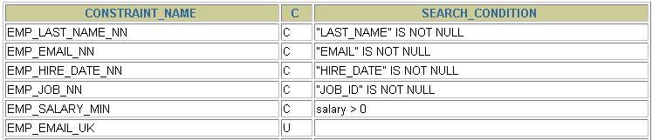
Viewing Constraints
Query the USER_CONSTRAINTS table to view all
constraint definitions and names.
SELECT constraint_name, constraint_type,
search_condition
FROM user_constraints
WHERE table_name = 'EMPLOYEES';
…
Notes:
Viewing Constraints
After creating a table, you can confirm its existence by issuing a DESCRIBE command. The only constraint that you can verify is the NOT NULL constraint. To view all constraints on your table, query the USER_CONSTRAINTS table.
The example on the slide displays the constraints on the EMPLOYEES table.
Note: Constraints that are not named by the table owner receive the system-assigned constraint name. In constraint type, C stands for CHECK, P for PRIMARY KEY, R for referential integrity, and U for UNIQUE key. Notice that the NOT NULL constraint is really a CHECK constraint.
Instructor Note
Point out to students that the NOT NULL constraint is stored in the data dictionary as a CHECK constraint. Draw their attention to the constraint type, for the NOT NULL constraints in the slide. The entry in the constraint_type field is C (as in CHECK) for these constraints.

Slide 59
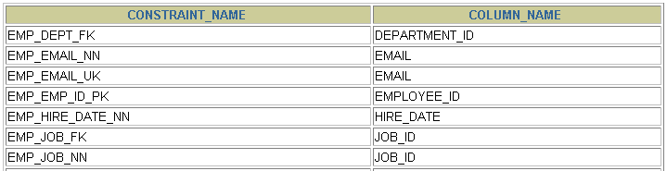
Viewing the Columns Associated with Constraints
View the columns associated with the constraint
names in the USER_CONS_COLUMNS view.
SELECT constraint_name, column_name
FROM user_cons_columns
WHERE table_name = 'EMPLOYEES';
…
Notes:
Viewing Constraints (continued)
You can view the names of the columns involved in constraints by querying the USER_CONS_COLUMNS data dictionary view. This view is especially useful for constraints that use system-assigned names.

Slide 60
Example
create table student1 (Stud_id number(3) primary key, Stud_name varchar2(20), Gender varchar2(1), Address varchar2(10), DOB date not null);
insert into student1 values(01,'Smith','M','Pune','5-feb-1999');
insert into student1 values(02,'Mrunal','F','Satara','1-Jan-2000');
insert into student1 values(02,'Priya','F','Satara','10-Dec-2000');
ORA-00001: unique constraint (HR.SYS_C004176) violated

Slide 61
DCL Commands
DCL is abbreviation of Data Control Language.
It permit a user to access, modify or work on the different privileges in order to control the database.
It allows the database owner to give access, revoke access, and change the given permissions as and when required.
It is used to create roles, permissions, and referential integrity as well it is used to control access to database by securing it.
Examples: GRANT, REVOKE statements.

Slide 62
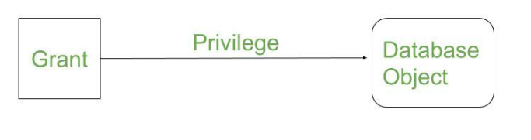
DCL:1) Grant Command
Grants permissions to the user on the database objects.
GRANT command allows specified users to perform specified tasks.
It is used to assigning permissions to users. (Only DBA can assign).
Syntax: grant privilege_name on object_name to {user_name | public | role_name} ;

Slide 63
DCL:1) Grant Command Conti…
Syntax: grant privilege_name on object_name to {user_name | public | role_name} ;
object_name: The name of the database object that you are granting permissions for. In the case of granting privileges on a table, this would be the table name.
privilege_name: The privileges to assign. It can be SELECT,INSERT, UPDATE, DELETE, ALTER,ALL(ALL PRIVILLEGES).
user_name: The name of the user that will be granted these privileges.
public: Used to provide access to all users.
ROLES : are a set of privileges grouped together.

Slide 64
For example,
if you wanted to grant SELECT, INSERT, UPDATE, and DELETE privileges on a table called employees to a user name smithj, you would run the following GRANT statement:
For example GRANT SELECT, INSERT, UPDATE, DELETE ON employees TO smithj;
You can also use the ALL keyword to indicate that you wish to grant permissions (ie: SELECT, INSERT, UPDATE, DELETE, and REFERENCES) to a user named smithj.
For example: GRANT ALL ON employees TO smithj;
If you wanted to grant only SELECT access on the employees table to all users, you could grant the privileges to the public role.
For example: GRANT SELECT ON employees TO public;

Slide 65
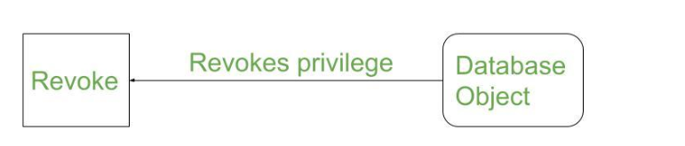
DCL: 2) Revoke
Revoking Privileges: It get back permissions from the users.
Syntax: revoke <permission> on <object_name> from <username>;
Examples
revoke all on emp from user1; ‘get back all permissions from user1.
revoke select on emp from public; ‘get back select permission from all users.

Slide 66
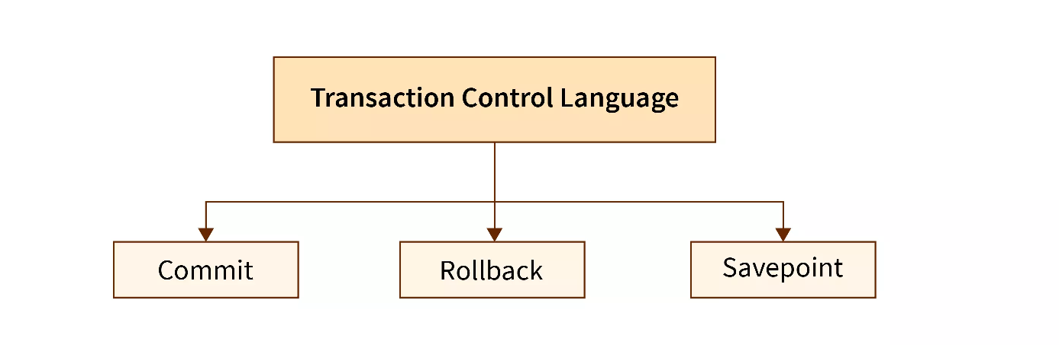
4) TCL
TCL is abbreviation of Transactional Control Language. It is used to manage different transactions occurring within a database.

Slide 67
TCL Commands
COMMIT:
The COMMIT command in SQL is used to permanently save any transaction into the database.
Generally, whenever we use any DML command such as INSERT, UPDATE, or DELETE, the changes made by these commands are , not permanent.
Hence, before closing the current session, we may roll back any changes made through these commands.
Eg. commit; ‘i.e end or start a transaction
Major Highlights:
COMMIT save all the modifications done (all the transactions) by the DML commands in the database.
We must write the COMMIT command before and after every DDL command to save the change permanently in the database.
Once COMMIT is performed, it cannot be undone unless it is rolled back.

Slide 68
ROLLBACK OR REVERT
The rollback command is used for restoring the database to the last committed state.
In other words, the rollback command restores the database to its original state since the last command that was committed.
Eg. rollback; ‘i.e undo upto commit.
Eg. rollback to P1;
Major Highlights:
ROLLBACK is used to undo the transactions that have not already been permanently saved (or committed) to the database.
The ROLLBACK command restores the previously stored value, that is, the data present before the execution of the transactions.
SAVEPOINT:
The SAVEPOINT command is used to temporarily save a transaction so that we can roll back to that point (saved point) whenever required.
Syntax: SAVEPOINT savepoint_name
Eg. savepoint P1;

Slide 69
DQL
DATA QUERY LANGUAGE
DQL is used to fetch the data from the database.
It uses only one command AS
SELECT

Slide 70
SELECT COMMAND
The SELECT statement is used to select data from a database or table. The tabular result is stored in a result table called the result-set.
Syntax
SELECT column_name(s) FROM table_name ;
Clauses of the SELECT statement:
SELECT - List the columns (and expressions) that should be returned from the query
FROM - Indicate the table(s) or view(s) from which data will be obtained
WHERE - Indicate the conditions under which a row will be included in the result
GROUP BY - Indicate columns to group the results
HAVING - Indicate the conditions under which a group will be included
ORDER BY - Sorts the result according to specified columns

Slide 71
Table Name : customers
CustomerID | CustomerName | ContactName | Address | City | PostalCode | Country
1 | Alfreds Futterkiste | Maria Anders | Obere Str. 57 | Berlin | 12209 | Germany
2 | Ana Trujillo Emparedados y helados | Ana Trujillo | Avda. de la Constitución 2222 | México D.F. | 05021 | Mexico
3 | Antonio Moreno Taquería | Antonio Moreno | Mataderos 2312 | México D.F. | 05023 | Mexico
4 | Around the Horn | Thomas Hardy | 120 Hanover Sq. | London | WA1 1DP | UK
5 | Berglunds snabbköp | Christina Berglund | Berguvsvägen 8 | Luleå | S-958 22 | Sweden
6 | Blauer See Delikatessen | Hanna Moos | Forsterstr. 57 | Mannheim | 68306 | Germany
7 | Blondel père et fils | Frédérique Citeaux | 24, place Kléber | Strasbourg | 67000 | France
8 | Bólido Comidas preparadas | Martín Sommer | C/ Araquil, 67 | Madrid | 28023 | Spain
9 | Bon app' | Laurence Lebihans | 12, rue des Bouchers | Marseille | 13008 | France
10 | Bottom-Dollar Marketse | Elizabeth Lincoln | 23 Tsawassen Blvd. | Tsawassen | T2F 8M4 | Canada

Slide 72
To select whole data from table : SELCT * FROM <TABLENAME>; Ex: select * fromt SELECT * FROM Customers;
CustomerID | CustomerName | ContactName | Address | City | PostalCode | Country
1 | Alfreds Futterkiste | Maria Anders | Obere Str. 57 | Berlin | 12209 | Germany
2 | Ana Trujillo Emparedados y helados | Ana Trujillo | Avda. de la Constitución 2222 | México D.F. | 05021 | Mexico
3 | Antonio Moreno Taquería | Antonio Moreno | Mataderos 2312 | México D.F. | 05023 | Mexico
4 | Around the Horn | Thomas Hardy | 120 Hanover Sq. | London | WA1 1DP | UK
5 | Berglunds snabbköp | Christina Berglund | Berguvsvägen 8 | Luleå | S-958 22 | Sweden
6 | Blauer See Delikatessen | Hanna Moos | Forsterstr. 57 | Mannheim | 68306 | Germany
7 | Blondel père et fils | Frédérique Citeaux | 24, place Kléber | Strasbourg | 67000 | France
8 | Bólido Comidas preparadas | Martín Sommer | C/ Araquil, 67 | Madrid | 28023 | Spain
9 | Bon app' | Laurence Lebihans | 12, rue des Bouchers | Marseille | 13008 | France
10 | Bottom-Dollar Marketse | Elizabeth Lincoln | 23 Tsawassen Blvd. | Tsawassen | T2F 8M4 | Canada

Slide 73
To select the columns by using a SELECT statement like this:
SELECT CustomerID ,CustomerName FROM customers;
CustomerID | CustomerName
1 | Alfreds Futterkiste
2 | Ana Trujillo Emparedados y helados
3 | Antonio Moreno Taquería
4 | Around the Horn
5 | Berglunds snabbköp
6 | Blauer See Delikatessen
7 | Blondel père et fils
8 | Bólido Comidas preparadas
9 | Bon app'
10 | Bottom-Dollar Marketse

Slide 74
Where Clause
The WHERE clause is used to specify a selection criterion.
To conditionally select data from a table, a WHERE clause can be added to the SELECT statement.
Syntax
SELECT column FROM table WHERE column operator value

Slide 75
With the WHERE clause, the following operators can be used:
Operator
Description
=
Equal
<>
Not equal
>
Greater than
<
Less than
>=
Greater than or equal
<=
Less than or equal
BETWEEN
Between an inclusive range
LIKE
Search for a pattern
Note: In some versions of SQL the <> operator may be written as !=

Slide 76
1) Using the WHERE Clause
To select only the persons living in the city "Sandnes", we add a WHERE clause to the SELECT statement:
SELECT * FROM Persons WHERE City='Sandnes'
SrNo | LastName | FirstName | Address | City | Year
1 | Hansen | Ola | Timoteivn 10 | Sandnes | 1951
2 | Svendson | Tove | Borgvn 23 | Sandnes | 1978
3 | Svendson | Stale | Kaivn 18 | Sandnes | 1980
4 | Pettersen | Kari | Storgt 20 | Satavnager | 1960
Sr.No | LastName | FirstName | Address | City | Year
1 | Hansen | Ola | Timoteivn 10 | Sandnes | 1951
2 | Svendson | Tove | Borgvn 23 | Sandnes | 1978
3 | Svendson | Stale | Kaivn 18 | Sandnes | 1980

Slide 77
The LIKE Condition
The LIKE condition is used to specify a search for a pattern in a column.
Syntax
SELECT column FROM table WHERE column LIKE pattern ;
A "%" sign can be used to define wildcards (missing letters in the pattern) both before and after the pattern.
A “?” sign can be used to define a single character.

Slide 78
Using LIKE
The following SQL statement will return persons with first names that start with an 'O':
SELECT * FROM Persons WHERE FirstName LIKE 'O%' ;
The following SQL statement will return persons with first names that end with an 'a':
SELECT * FROM Persons WHERE FirstName LIKE '%a' ;
The following SQL statement will return persons with first names that contain the pattern 'la':
SELECT * FROM Persons WHERE FirstName LIKE '%la%'

Slide 79
A “?” sign can be used to define a single character.
SELECT Year , LastName Persons WHERE LastName like ‘H?’;
Result :
Year | LastName
1951 | H

Slide 80
SELECT WITH BETWEEN OPERATER
Between : search rannge from given database .
SELECT FirstName FROM Persons where SrNo BETWEEN 2 AND 4;
RESULT :
FirstName
Tove
Stale
Kari

Slide 81
SELECT WITH LOGICAL OPERATOR
AND,OR,NOT
1) SELECT SrNo,FirstName FROM Persons where Year =1951 OR Year= 1980 ;
Result :
SrNo | FirstName
1 | Ola
3 | Stale
2) SELECT SrNo,FirstName FROM Persons where LastName NOT like Svendson
SrNo | FirstName
1 | Ola
4 | Kari

Slide 82
2) ORDER BY CLAUSE
The SQL ORDER BY clause is used to sort the data in either ascending or descending order, based on one or more columns.
The ORDER BY keyword sorts the records in ascending order by default. To sort the records in descending order, use the DESC keyword.
ORDER BY is used with the SQL SELECT statement and is usually specified after the WHERE, HAVING, and GROUP BY clauses, if present in the query.
Note −
Some databases sort the query results in an ascending order by default.
To sort the data in ascending order, we use the keyword ASC.
To sort the data in descending order, we use the keyword DESC

Slide 83
SELECT column-list FROM table_name [ORDER BY column1, column2, .. columnN] [ASC | DESC];

Slide 84
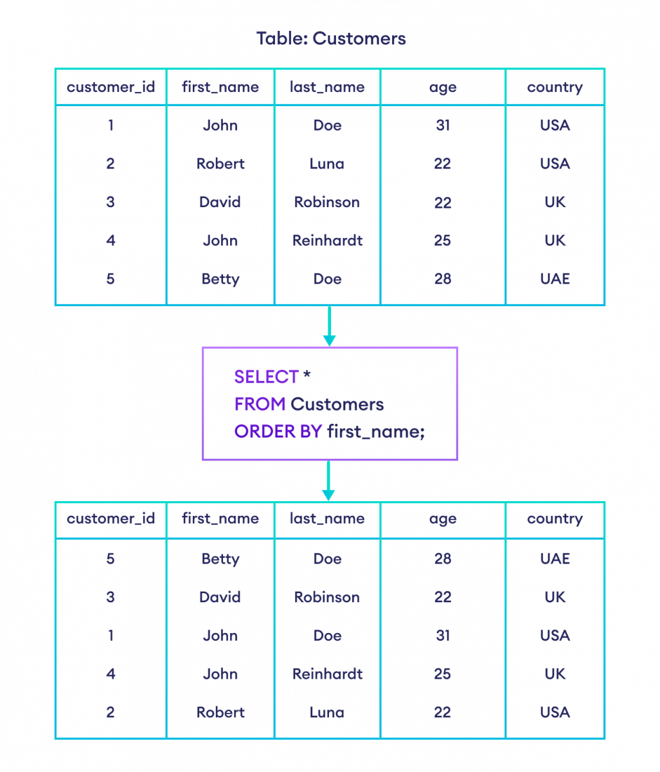
ORDER BY with ASC
SELECT * FROM CUSTOMERS ORDER BY first_name ASC ;
OR
SELECT * FROM CUSTOMERS ORDER BY first_name ;

Slide 85

; SELECT * FROM Customers ORDER BY age ASC

Slide 86
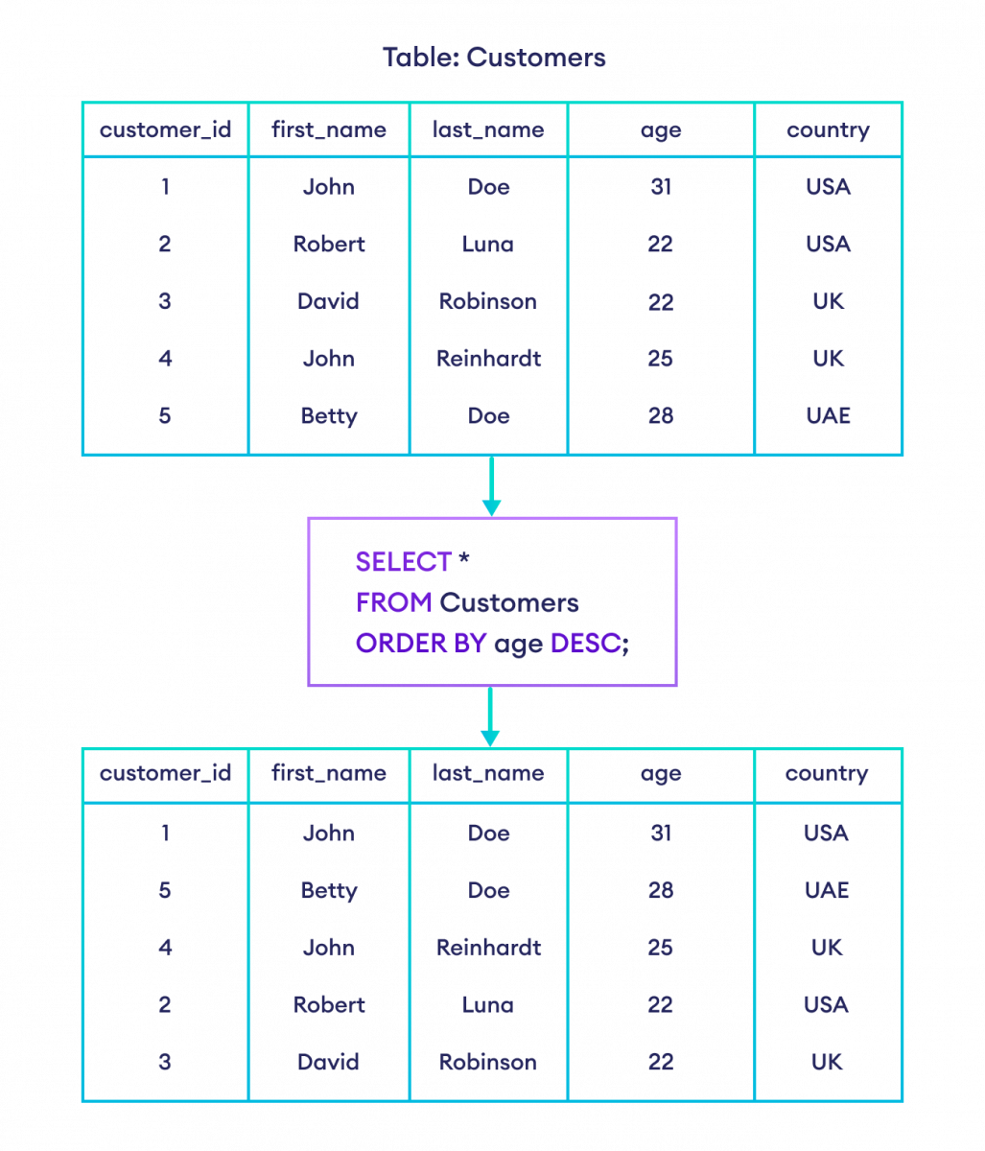
ORDER BY with DESC
SELECT * FROM CUSTOMERS ORDER BY age DESC;

Slide 87
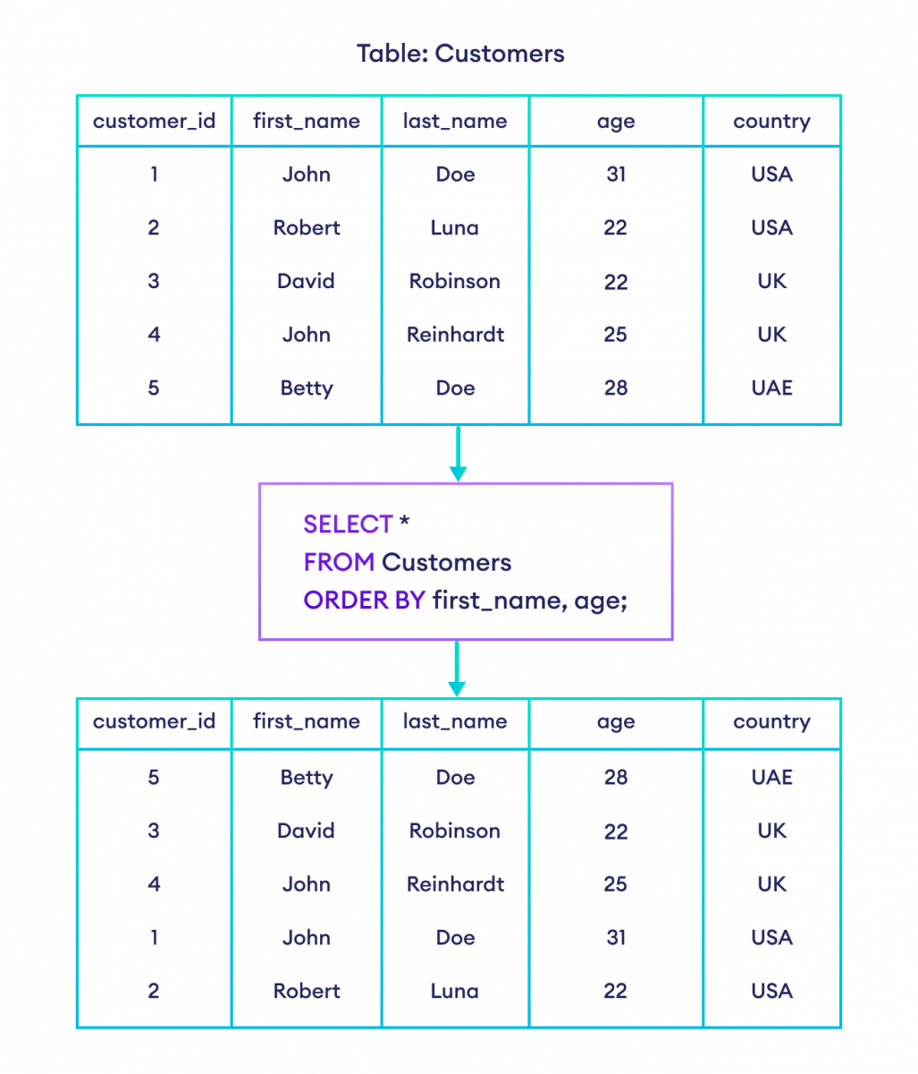
SELECT * FROM Customers ORDER BY first_name, age;

Slide 88
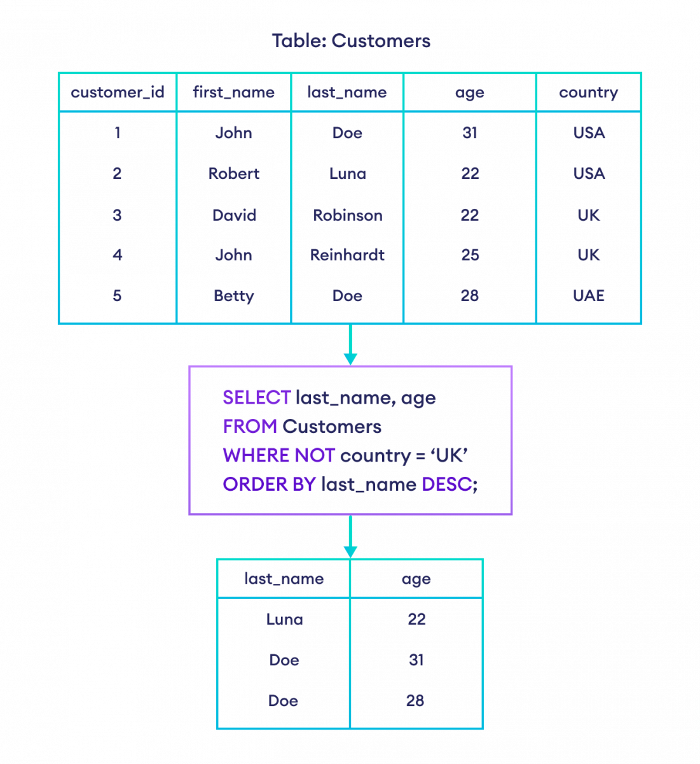
ORDER BY with WHERE clause
SELECT last_name, age FROM Customers WHERE NOT country = 'UK' ORDER BY last_name DESC;

Slide 89
3) Group by Clause
The Group By statement is used for organizing similar data into groups. The data is further organized with the help of equivalent function. It means, if different rows in a precise column have the same values, it will arrange those rows in a group.
The SELECT statement is used with the GROUP BY clause in the SQL query.
WHERE clause is placed before the GROUP BY clause in SQL.
ORDER BY clause is placed after the GROUP BY clause in SQL.
GROUP BY Syntax
SELECT column1, column2, ... FROM table GROUP BY columnA, columnB, ...;
Here,
column1, column2 ... are the columns of the table
Table is the name of the table from where the rows are selected
columnA, columnB ... are the column(s) based on which the rows will be grouped

Slide 90
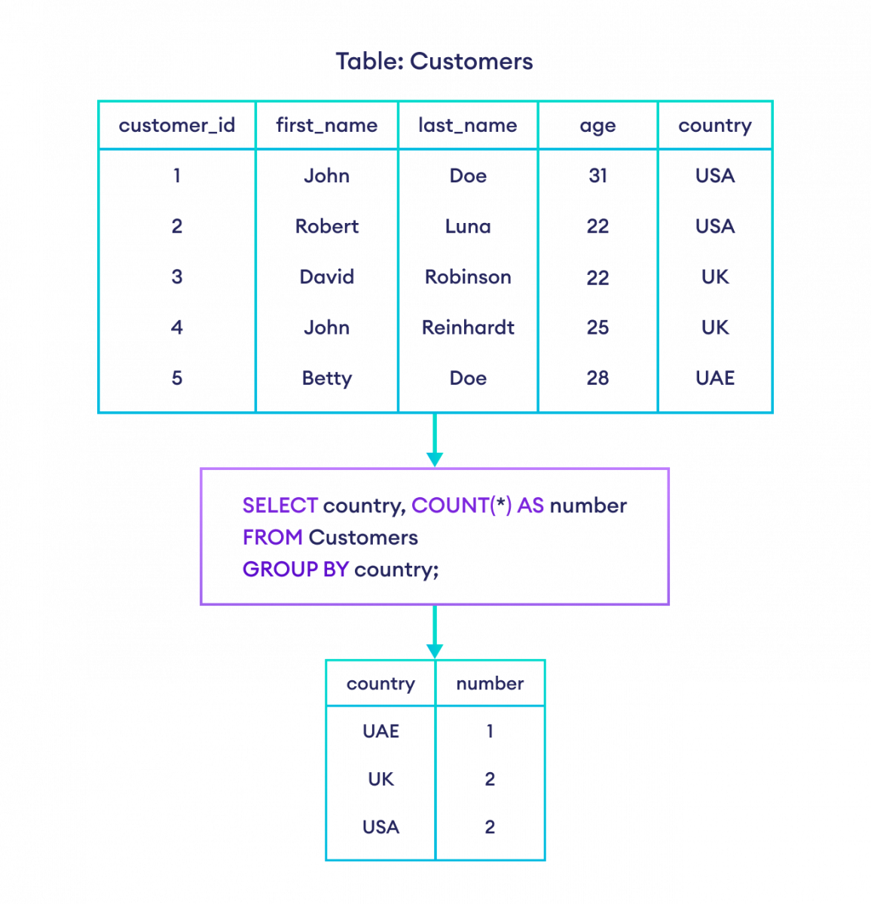
NOTE:
The GROUP BY clause is used in conjunction with aggregate functions such as MIN() and MAX(), SUM() and AVG(), COUNT(), etc.

Slide 91
Example :

Slide 92
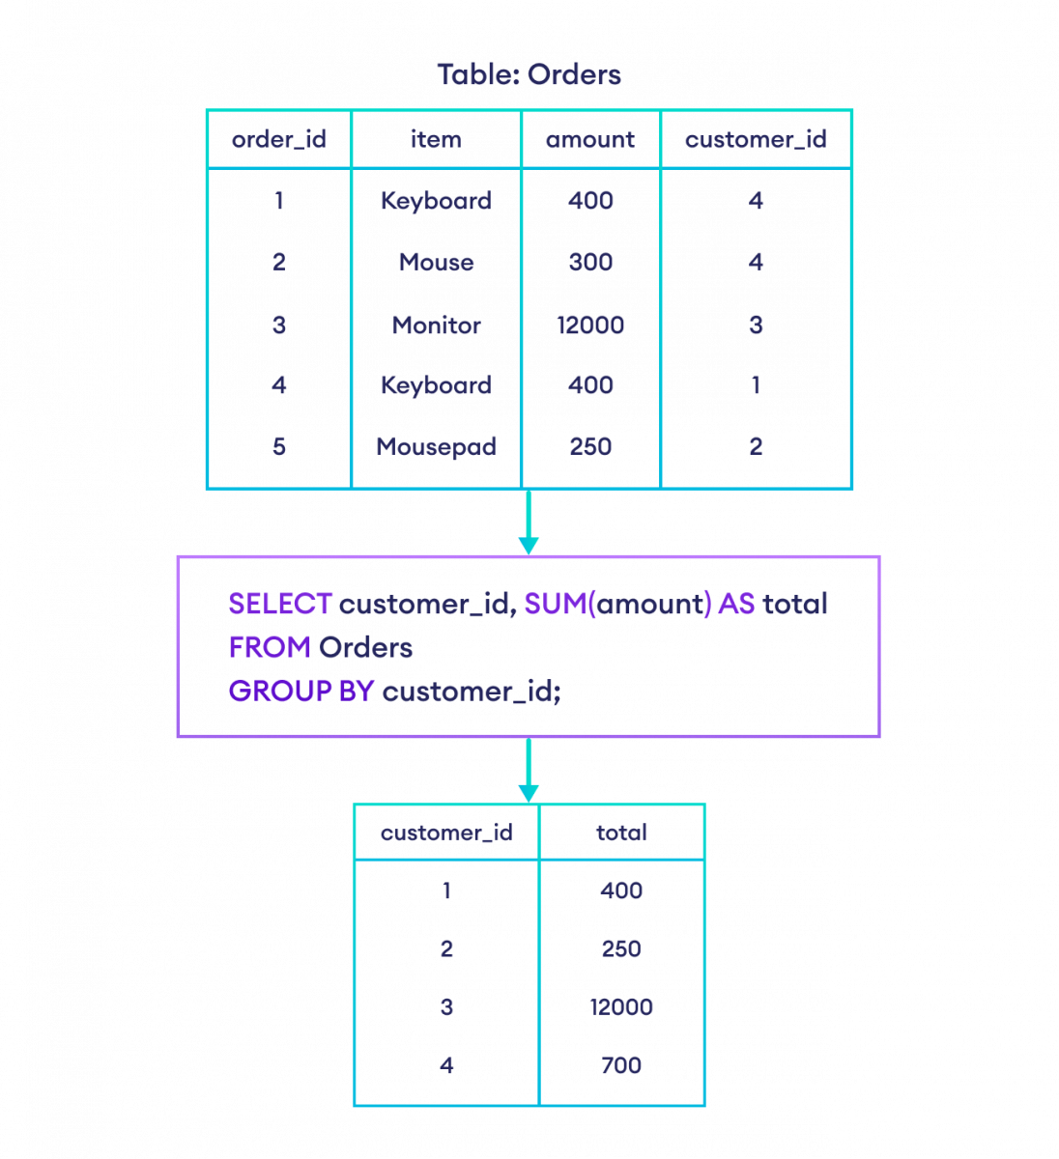
SELECT customer_id, SUM(amount) AS total FROM Orders GROUP BY customer_id ;;
Example :

Slide 93
GROUP BY With Multiple Columns
GROUP BY can also be used to group rows based on multiple columns.
SELECT country, state, MIN(age) AS min_age FROM Persons GROUP BY country, state;
Here, the SQL command groups all persons with similar country and state, and gives the minimum age of each group.

Slide 94
Having Clause
The SQL HAVING clause is used if we need to filter the result set based on aggregate functions such as MIN() and MAX(), SUM() and AVG(), and COUNT().
SQL HAVING Syntax
SELECT AggFunc(column), extra_columns FROM table GROUP BY target_column HAVING condition
Here,
AggFunc(column) refers to any aggregate function applied to a column
extra_columns are other extra columns to filter
GROUP BY groups the data by target_column
HAVING condition compares the column to certain conditions that require filtering

Slide 95
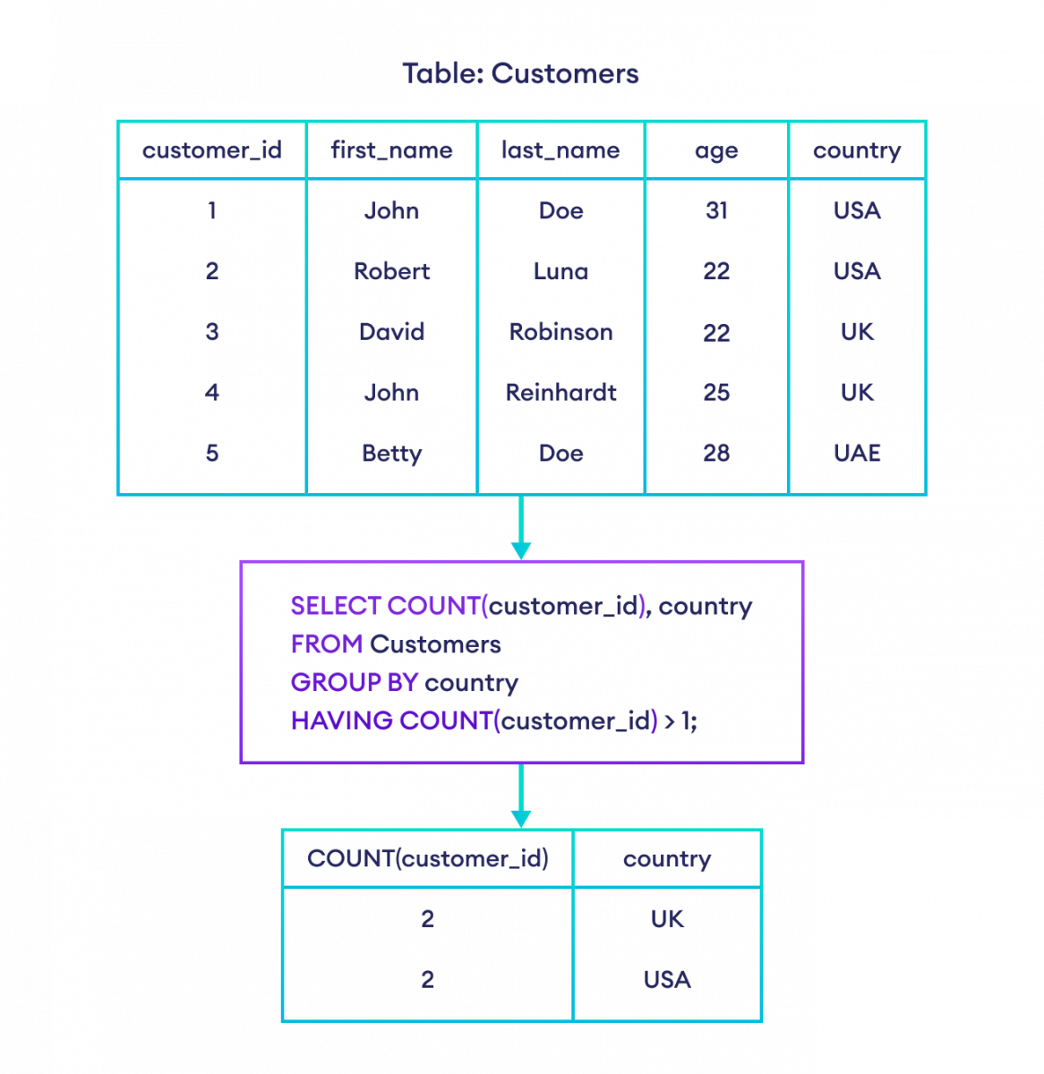
Example: SQL HAVING
SELECT COUNT(customer_id), country FROM Customers GROUP BY country HAVING COUNT(customer_id) > 1;
Here, the SQL command:
counts the number of rows by grouping them by country
returns the result set if their count is greater than 1.

Slide 96
Normalization
Normalization is the process to eliminate data redundancy and enhance data integrity in the table.
Normalization is the process of organizing the data in the database.
Normalization is used to minimize the redundancy from a relation or set of relations. It is also used to eliminate undesirable characteristics like Insertion, Update, and Deletion Anomalies.
Normalization divides the larger table into smaller and links them using relationships.
The normal form is used to reduce redundancy from the database table.
The main reason for normalizing the relations is removing these anomalies.

Slide 97
Types of Normal Forms:
First Normal Form (1NF)
Second Normal Form (2NF)
Third Normal Form (3NF)
Boyce Codd Normal Form (BCNF)

Slide 98
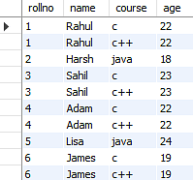
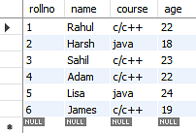
1st Normal Form (1NF)
A table is referred to as being in its First Normal Form if atomicity of the table is 1.
Here, atomicity states that a single cell cannot hold multiple values. It must hold only a single-valued attribute.
The First normal form disallows the multi-valued attribute, composite attribute, and their combinations.
BEFORE
AFTER Applying 1NF

Slide 99
Second Normal Form (2NF)
In the 2NF, relational must be in 1NF .
In the second normal form, all non-key attributes are fully functional dependent on the primary key

Slide 100
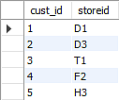
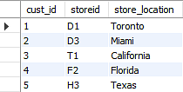
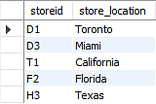
In given table possesses a composite primary key cust_id, storeid. The non-key attribute is store_location. So, store_location only depends on storeid, which is a part of the primary key. Hence, this table does not fulfill the second normal form.
To bring the table to Second Normal Form, you need to split the table into two parts. This will give you the tables as

Slide 101
Third Normal Form (3NF)
The first condition for the table to be in Third Normal Form is that the table should be in the Second Normal Form.
The second condition is that there should be no transitive dependency for non-prime attributes, which indicates that non-prime attributes (which are not a part of the candidate key) should not depend on other non-prime attributes in a table.
The third Normal Form ensures the reduction of data duplication
No Transitive dependency

Slide 102

Transitive Dependency
Example: Book → Author: Here, the Book attribute determines the Author attribute. If you know the book name, you can learn the author's name. However, Author doesn't determine Book, because an author can write multiple books.
In the above student table, stu_id determines subid, and subid determines sub. Therefore, stu_id determines sub via subid. This implies that the table possesses a transitive functional dependency, and it does not fulfill the third normal form criteria.

Slide 103

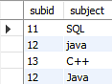
To change the table to the 3NF, we need to divide the table as shown below:

Slide 104
Boyce Codd Normal Form (BCNF)
Boyce Codd Normal Form is also known as 3.5 NF. It is the superior version of 3NF .
The first condition for the table to be in Boyce Codd Normal Form is that the table should be in the third normal form.
Secondly, every Right-Hand Side (RHS) attribute of the functional dependencies should depend on the super key of that particular table.
It means You have a functional dependency X → Y. In the particular functional dependency, X has to be the part of the super key of the provided table.

Slide 105
Example
In the above table, student_id and subject together form the primary key because using student_id and subject; you can determine all the table columns.
Another important point to be noted here is that one professor teaches only one subject, but one subject may have two professors.
Which exhibit there is a dependency between subject and professor, i.e. subject depends on the professor's name

Slide 106
The table is in 1st Normal form as all the column names are unique, all values are atomic, and all the values stored in a particular column are of the same domain.
The table also satisfies the 2nd Normal Form, as there is no Partial Dependency.
And, there is no Transitive Dependency; hence, the table also satisfies the 3rd Normal Form.
This table follows all the Normal forms except the Boyce Codd Normal Form.
As you can see stuid, and subject forms the primary key, which means the subject attribute is a prime attribute.
However, there exists yet another dependency - professor → subject.
BCNF does not follow in the table as a subject is a prime attribute, the professor is a non-prime attribute.

Slide 107
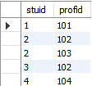
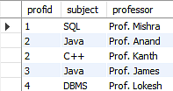
To transform the table into the BCNF, you will divide the table into two parts. One table will hold stuid which already exists and the second table will hold a newly created column profid.
And in the second table will have the columns profid, subject, and professor, which satisfies the BCNF.

Slide 108
Why we have Keys in DB?
A Key is an attribute or a set of attributes in a relation that identifies a tuple (record) in a relation.
The keys are defined in a table to access or sequence the stored data quickly
and smoothly.
They are also used to create relationship between different tables.

Slide 109
Types of Keys in Database
Primary Key
Candidate Key
Alternate Key
Super Key
Composite Key
Foreign Key
Unique Key

Slide 110
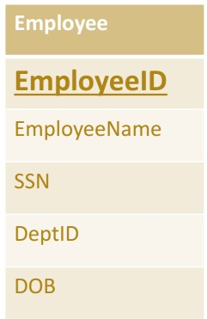
Prim ary Key
Which is Unique & Can’ t be have NULL Value
Is the column you choose to maintain uniqueness in a table at row level.
Here in Employee table we can choose either EmployeeID or SSN column for a PRIMARY K.EY.
EmployeeID is preferable choice because SSN is a secure (PII) value.
Primary key is the minimal super keys. In the ER diagram primary key is represented by underlining the primary key attribute.
Ideally a primary key is composed of only a single attribute.
But it is possible to have a primary key composed of more than one attribute
.

Slide 111
To define a field as primary key, following conditions had to be met :
No two rows can have the same primary key value.
Every row must have a primary key value.
The primary key field cannot be null.
Value in a primary key column can never be modified or updated, if any foreign key refers to that primary key

Slide 112
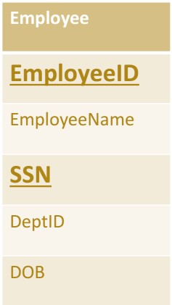
Candidate Key
Are individual columns in a table that qualifies for uniqueness of each row/tuple.
Here in Employee table EmployeeID & SSN are eligible
for a Primary Key and thus are Candidate keys.
Candidate Keys are super keys for which no proper subset is a super key. In other words candidate keys are
minimal super keys.

Slide 113
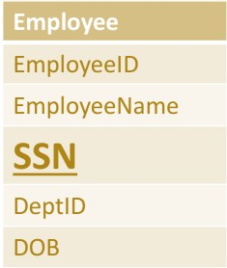
Alternate Key
Candidate column other the Primary column, like if EmployeeID is set for a PK then SSN would be the Alternate key.

Slide 114
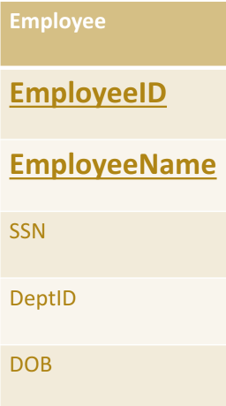
Super Key
If you add any other Column /Attribute to a Primary Key then it become a Super Key, like EmployeeID
+ EmployeeName is a Super Key.
Super key stands for superset of a key.
A Super Key is a set of one or more attributes that are taken collectively and can identify all other attributes uniquely.

Slide 115
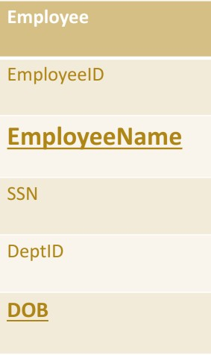
Composite Key
If a table do have a single column that qualifies for a Candidate key, then you have to select 2 or more columns to make a row unique.
Like if there is no EmployeeID or SSN columns, then you can make EmployeeNam e + DateOfBirth (DOB) as Composite Primary Key. But still there can be a narrow chance of duplicate rows.

Slide 116
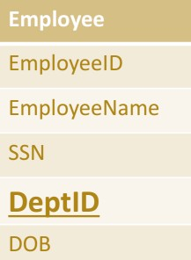
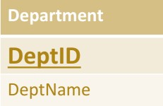
Foreign Key
Here in below tables DeptID of Department table is Primary Key where as
DeptID of Employee is an Foreign key.
It means it has referred to another table. This concept is also know as
Referential Integrity.

Slide 117
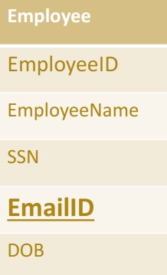
Unique Key
Unique key is same as primary with the difference being the existence of null.
Unique key field allows one value as NULL value.

